Slide 1


Example App
HW 2:
Add ne component named: sendmail
Change e-mail field to new format:
Create event binding (click) showing a new form with fields: To, Cc, Subject, Message field and Send button
Create new service named sendmailMessage, showing, each time we click a Send button (from email form), a confirm message
Upload solution to GitHub
Attach GitHub link to HM2

Slide 2
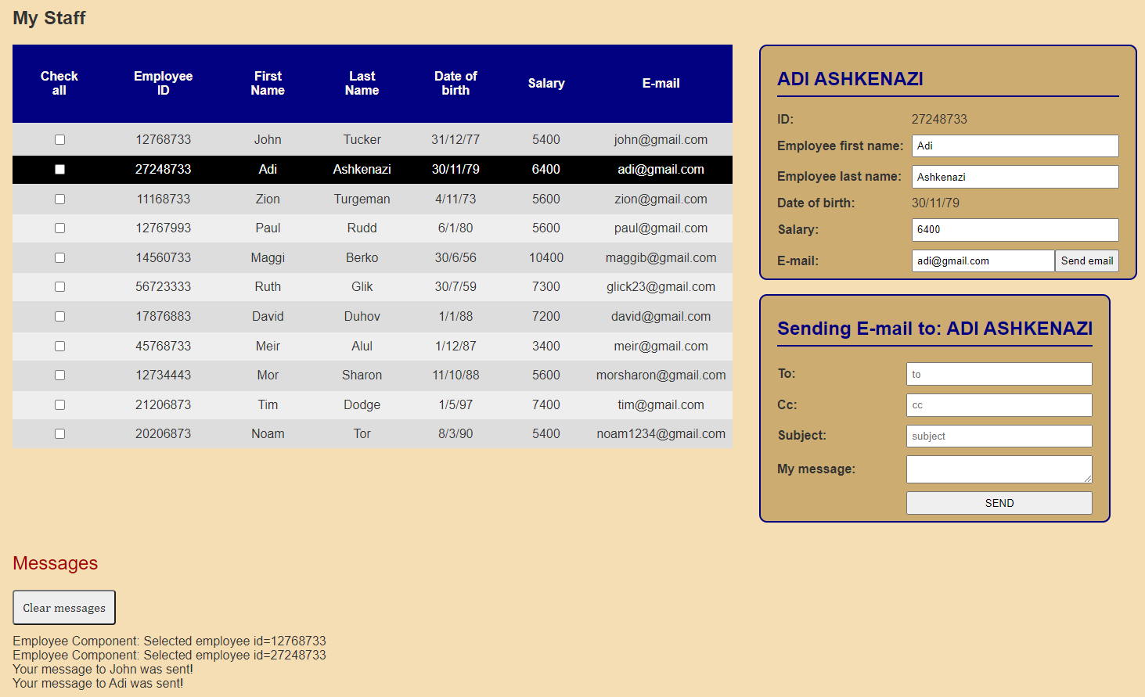
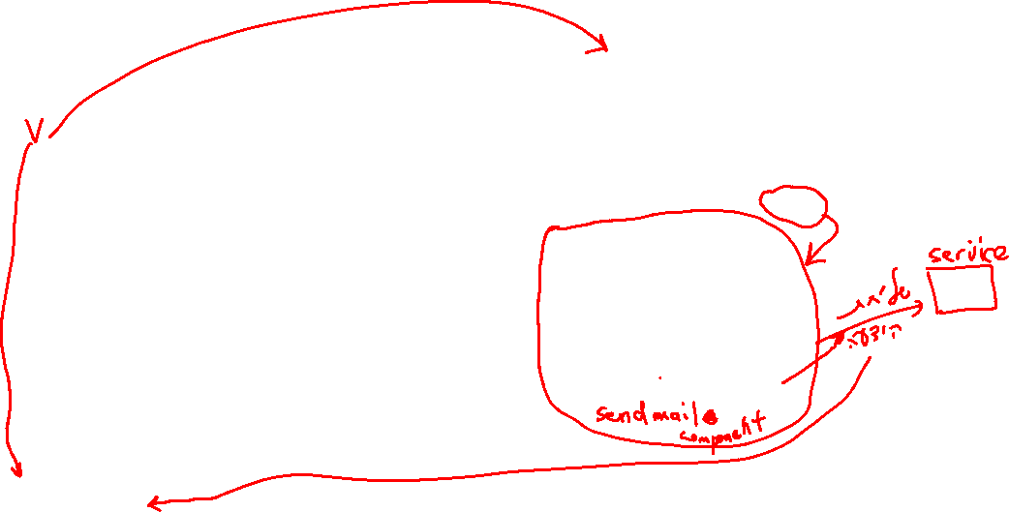
Example App
HW 2:

